Slide 1

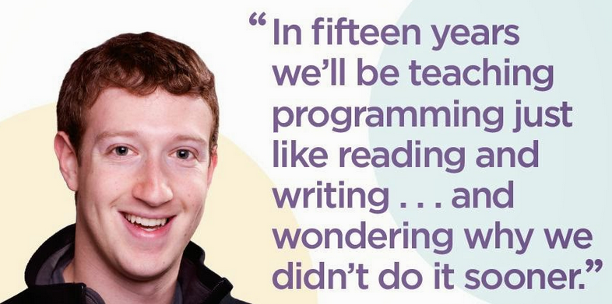


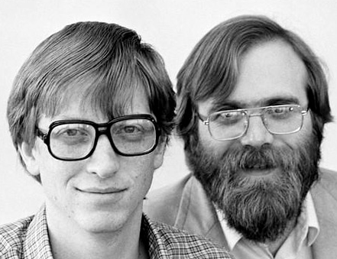
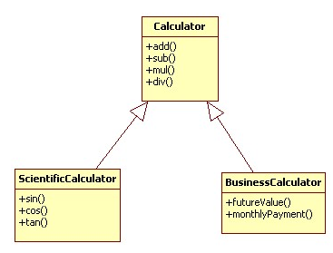
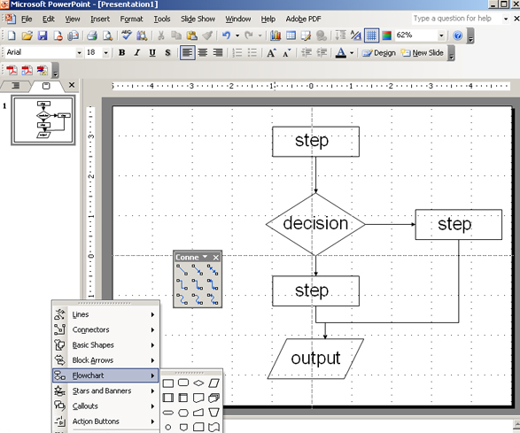


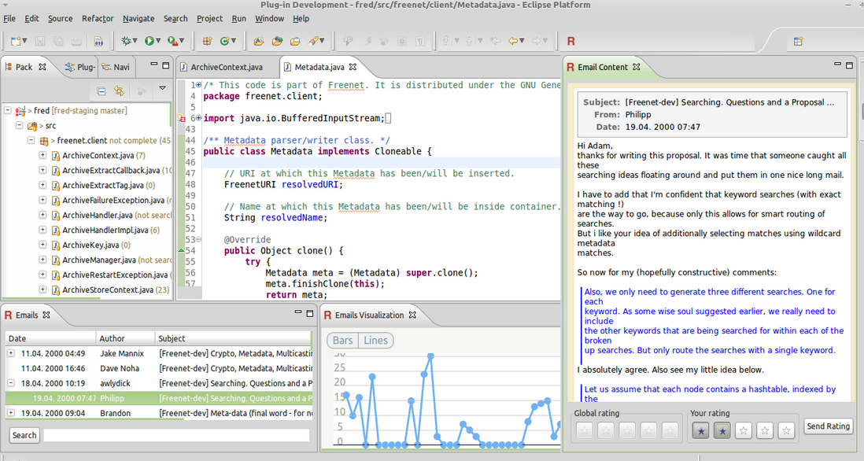

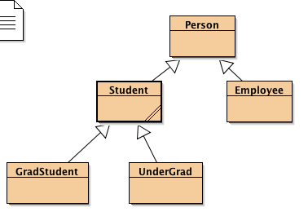

AP Computer Science
Course Introduction 2016/17
Mr. Mauro

Slide 2
Computer Login
UserName:
LastName+FirstInitial+Last 4 digits of student perm ID# Examples: John Smith - ID# 1234567 = smithj4567 Jane Doe - ID# 9876543 = doej6543
Password: The first time you log in, you will use your full permanent ID# as their password. After entering that, you will be prompted to change your password.

Slide 3
Google Classroom
We will be using Google classroom for most assignment distribution and collection
Log out of any personal gmail account
Log into your sduhsd.net gmail account
Go to classroom.google.com
You will enroll in the Google class today…

Slide 4
Electronic Storage Options
Lost or deleted files will have to be redone so please save your stuff!!! With the exception of Android Studio projects, do NOT store your work on the class local drives – they will be deleted by district IT!
H: drive
Thumb drive
Google drive
Dropbox
Github: You will be required to use Github for your projects
If you have your own laptop you are encouraged to use it in class
Eclipse and Android Developer Studio are free

Slide 5
Course Description
This course will provide students with a foundational knowledge of computer science and programming using the Java programming language.
Design and implement solutions to problems by writing, running, and debugging computer programs.
Use and implement commonly used algorithms and data structures.
Code fluently in an object-oriented paradigm using the programming language Java.
Read and understand a large program consisting of several classes and interacting objects. (An example of such a program is the AP Computer Science Case Study.)
Recognize the ethical and social implications of computer use

Slide 6


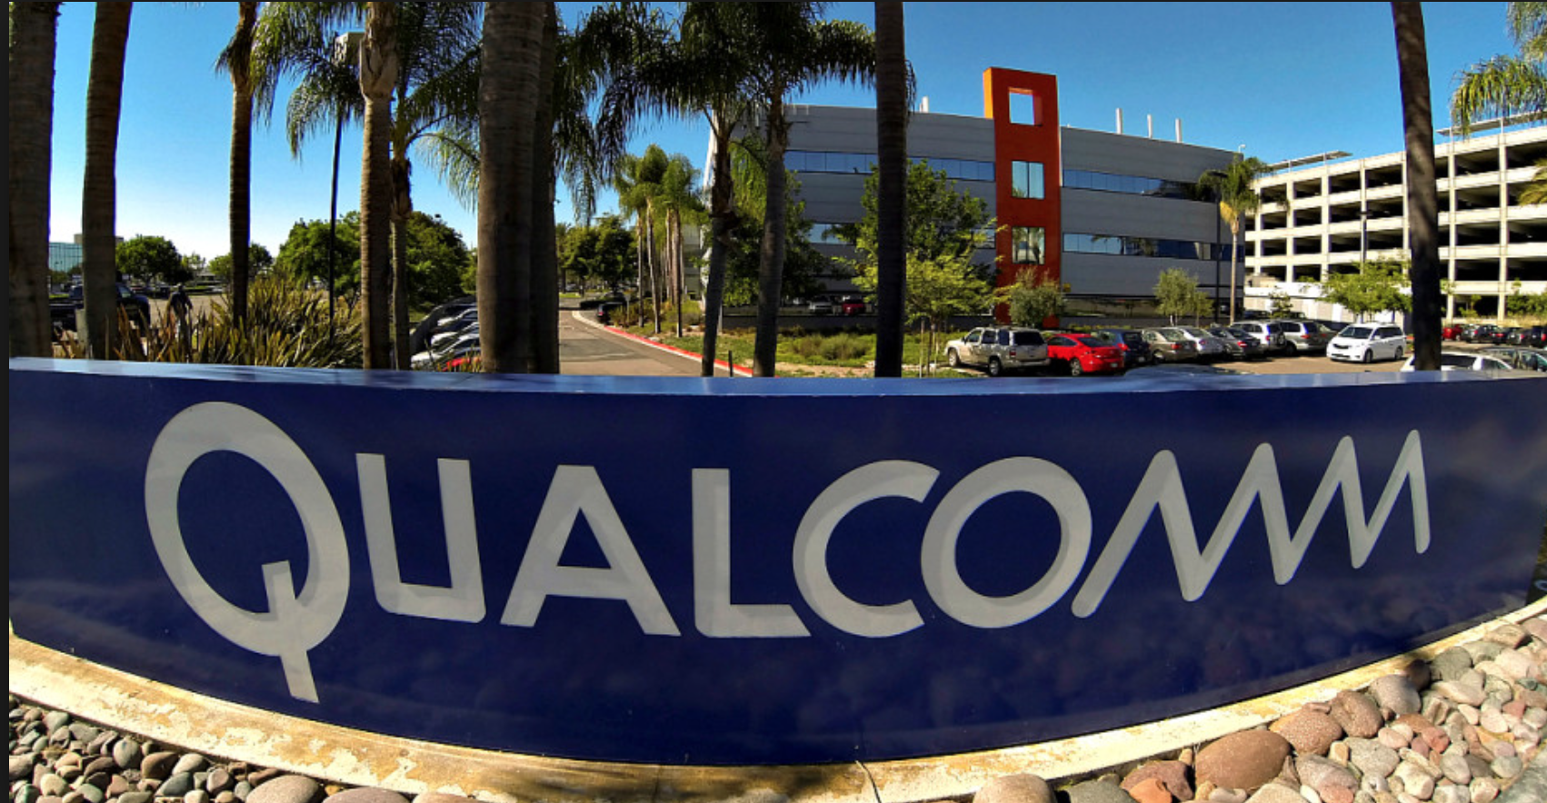
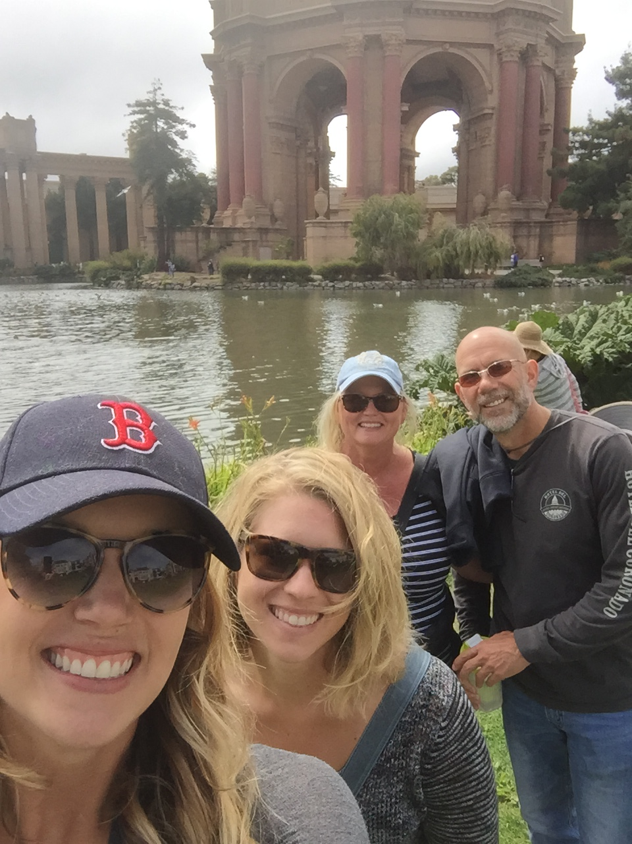
About Me
5th year teaching engineering and Computer Science at CCA
BS/MSEE degrees from Cal Poly and USC
Worked 1993-2015 at Qualcomm
Digital Signal Processing in Audio, Video and Graphics
Registered Patent Agent
Married with 2 daughters

Slide 7
Class Structure
Warmups, daily prompts (Participation grade)
Usually a codingbat.com short programming assignment
Discussion/demonstration
Class time to work on projects/presentations (Projects/labs grade)
One of the assigned labs will be checked off and/or turned into Google classroom
Weekly MC and FRQ assessments (MC_FRQ assessments and Pop Quizzes grade)
FRQ’s will be one of your lab assignments from the unit just covered
Pop quizzes are typically an in-class lab assessment (coding assignment)
Midterm and Final exams for each Quarter timed to the AP exam in May (Exams grade)
Homework amount will be dependent on your ability to finish assignments during class time

Slide 8
Grades & Makeup Work
Participation (10%)
Projects/Labs (10%)
MC_FRQ assessments and Pop Quizzes (40%)
Exams (40%)
All assignments will be posted on Google Classroom. You are responsible for making up work missed due to excused absences. I will not remind you to make up missed assignments.
Assignment grades will be posted in Aeries typically the Monday following the week it was due
Missing assignments will not be recorded (show up red). You will have 1 week to turn the assignment in for partial credit (50% or less)
Excused absences may be turned in the next day for full credit
The next Monday the “red” assignments will be updated with 0’s. You cannot make it up after that

Slide 9



Class Rules
Absolutely No Food or Drinks at Computers or in the robotics field!!!
Do not dispose of food/drink in class trash cans (use cans outside)
Get to class On-Time
Work on assignments from this class only
Be respectful to each other and class equipment
Do not be mean or insulting
Do not move, unplug, or alter equipment
Do not touch another student’s computer, keyboard, or cables
If you need to use the restroom let the teacher know before you leave.

Slide 10
Why Study Computer Science?
Job market is huge
Programming is becoming a requirement in most technical jobs
Can start your own company
Can make good $$
60K to 100K+ for BSCS degree
70K+ to start for MS

Slide 11
Day 1
Assignment:
Enroll in Google classroom and review the syllabus: code is…..
Take coding assessment
Download assessment from Google Classroom, fillout, and turn-in to Google classroom
Go to Codingbat.com. Sign up and share with me at tony.mauro@sduhsd.net. (Participation grade)
Setup github desktop
Launch Eclipse and follow instructions on Google classroom to setup your first project

